Slide 1
Jumping for JS
Day 8
August 3, 2016

Slide 2
Today’s Class

Slide 3
Objectives
In today’s class we’ll be covering:
Array Assignments
The Concept of For-Loops
The Art of Pseudo-Coding
Building Rock-Paper Scissors

Slide 4
Basics Recap

Slide 5
Deep Philosophy
What is Javascript?
(And what is it used for?)

Slide 6

Javascript Definitions
Javascript is the third of the three fundamental programming languages of the modern web (along with HTML, CSS)
Javascript allows developers to create dynamic web applications capable of taking in user inputs, changing what’s displayed to users, animating elements, and much more.

Slide 7
Please… Don’t Pick Me.
What is a Variable?
(And how do we declare one?)

Slide 8
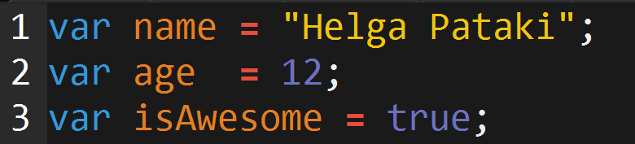
Basic Variables
Variables are the nouns of programming.
They are “things” (Numbers, Strings, Booleans, etc.)
They are composed of variable names and values

Slide 9
Please… Don’t Pick Me.
What is meant by console.log?
(And how does it differ from an alert, prompt, or confirm?)

Slide 10
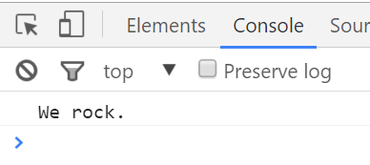
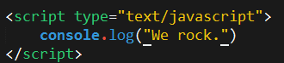
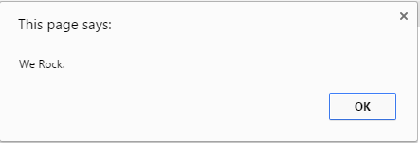
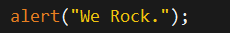
Basic Variables
Console.log displays discreetly to the debugger
Alert displays a pop-up message to the user

Slide 11
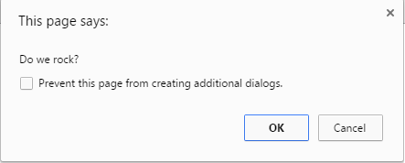

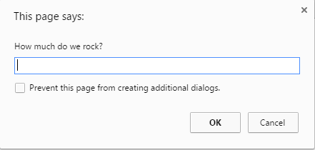
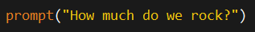
Basic Variables
Confirm displays a True/False popup.
Alert displays a prompt with a text-box input.

Slide 12
Please… Don’t Pick Me.
How do you “write” text to the HTML itself?

Slide 13
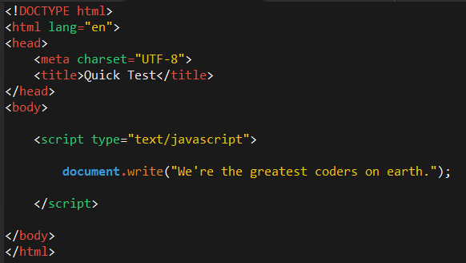

Writing to HTML
We can also use Javascript to directly write to the HTML page itself using document.write( ).
Later we will go over much more advanced approaches for writing HTML using Javascript and jQuery.
Test.html (chrome)
Test.html (sublime)

Slide 14
Please… Don’t Pick Me.
How do you check conditions?

Slide 15
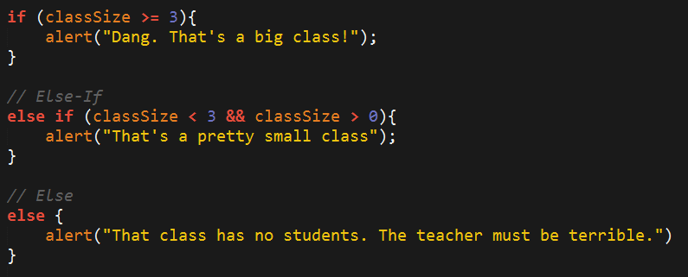
If-Then Statements
If-Then statements are critical.
Each statement is composed of an if, else-if, or else (keyword), a condition, and the resulting code in { } curly brackets.

Slide 16
Please… Don’t Pick Me.
What is an array?

Slide 17
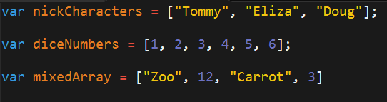
Basic Arrays
Arrays a type of variable that are collections.
These collections can be made up of strings, numbers, Booleans, other arrays, objects, anything.
Each element of the array is marked by an index. Indexes always start with 0.

Slide 18
> YOUR TURN!!
Activity: 1-JS Dissect | Suggested Time: 3 min
Code Dissection: Basic JS
Re-examine the file sent to you during yesterday’s class.
See if you can better understand how it works – after having gone through today’s class.
Prepare to share once the time is up.

Slide 19
> YOUR TURN!!
Activity: 2-CoolPeopleArray | Suggested Time: 5 min
Code Creation: Array Logging (If Needed)
Follow the instructions provided in the file to console.log each of the names in the “coolPeople” variable.
Hint: You should be repeating the same line 6 times.
Prepare to share once the time is up.

Slide 20
> YOUR TURN!!
Activity: 3-ArraySetting | Suggested Time: 7 min
Code Creation: Array Setting
Follow the instructions in the file provided to modify each of the elements in the array variable to make them lower case.
Only add in lines of code where told.
Hint: You will need to use the method .toLowerCase(). Research if you don’t remember how to use it.
Prepare to share once the time is up.

Slide 21
For Loops

Slide 22

Back to The Zoo Pen
Array Name: zooAnimals
Zebra
Rhino
Giraffe
Owl
Index 0
Index 1
Index 2
Index 3

Slide 23
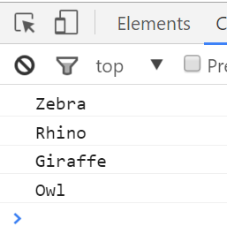
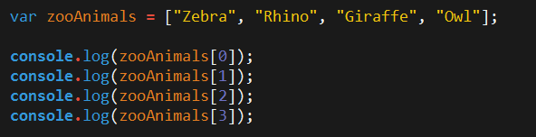
Back to The Zoo Pen (Logging)
Array Name: zooAnimals
Zebra
Rhino
Giraffe
Owl
Index 0
Index 1
Index 2
Index 3

Slide 24
Please… Don’t Pick Me.
What’s wrong here?

Slide 25
Don’t Repeat Yourself (DRY)
Repeated Code!
Let’s be more efficient

Slide 26
> YOUR TURN!!
Activity: 4-MyFirstLoop | Suggested Time: 5 min
Code Creation: For Loop Dissection
With a partner, spend a few moments trying to dissect the code sent to you.
Try to explain to one another what is happening with each line of code.
Feel free to do a bit of research to help. As a hint, look into the phrase: “For-Loop”
When time is up, feel free to explain.

Slide 27
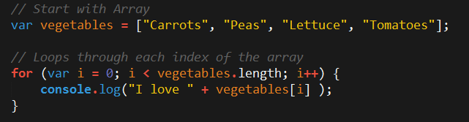
Enter the For-Loop
For loops are critical in programming.
We use for loops to run repeated blocks of code over a set period.
Each for loop is composed of a:
Variable declaration or counter (iterator)
A loop condition
An iteration (addition)

Slide 28
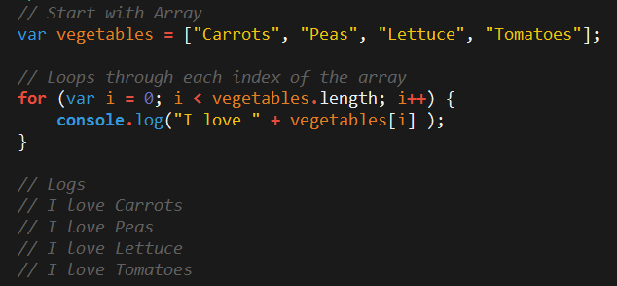
Enter the For-Loop
Iterator. Condition. Increment.

Slide 29
Enter the For-Loop
Code between the { } gets repeated each time the iterator is smaller than the condition. (i.e. in this case i < 4)

Slide 30
Enter the For-Loop
Running the code “loops” through and prints each element in the array.

Slide 31
Run That Loop
When i = 0 … console.log(“I love Carrots”)
Carrots
Peas
Lettuce
Tomatoes
Index 0
Index 1
Index 2
Index 3

Slide 32
Run That Loop
When i = 1 … console.log(“I love Peas”)
Carrots
Peas
Lettuce
Tomatoes
Index 0
Index 1
Index 2
Index 3

Slide 33
Run That Loop
When i = 2 … console.log(“I love Lettuce”)
Carrots
Peas
Lettuce
Tomatoes
Index 0
Index 1
Index 2
Index 3

Slide 34
Run That Loop
When i = 3 … console.log(“I love Tomatoes”)
Carrots
Peas
Lettuce
Tomatoes
Index 0
Index 1
Index 2
Index 3

Slide 35
> YOUR TURN!!
Activity: 5-ZooLoop | Suggested Time: 15 min
Code Creation: For-Loop Zoo
Spend a few moments, re-writing the code below using a for-loop.
Feel encouraged to use the code from the previous example as guide.
Then try to explain to the person next to you how the code works.

Slide 36
> YOUR TURN!!
Activity: 6-AnotherLoop | Suggested Time: 15 min
Code Creation: Another Loop (Time Permitting)
Starting from scratch, create a for loop that prints the following lines: I am 0 I am 1 I am 2 I am 3 I am 4
Don’t use an array in this case.
Start from scratch :-P

Slide 37

> YOUR TURN!!
Activity: 7-HardLoop | Suggested Time: 30 min
Code Creation: Hard Loop (Time Permitting)
Starting from scratch, create code that loops through the following array:
And prints out the names of the animals on the farm.
Then using the .charAt() method (research it) check if the first letter in the animal’s name begins with a “c” or “o”. If it does then create an alert saying: “Starts with c or an o!”

Slide 38
Rock Paper Scissors
Rest of Class!

Slide 39
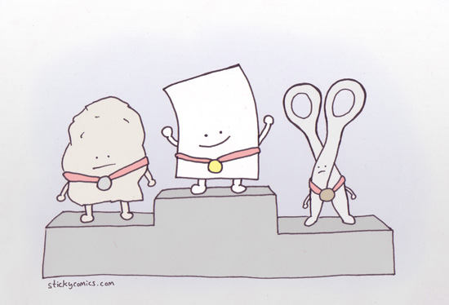
I’ma Beat You…
Play Rock Paper Scissors with the Person Next to You! Play 5 Rounds

Slide 40
> YOUR TURN!!
Activity: 8-PseudoCode | Suggested Time: 8 min
Code Creation: Pseudocode
With a partner, spend a few moments outlining all the steps and conditions that go into rock paper scissors.
Try to break it down into steps that you could “code out”
Think of basic elements like loops, if-then statements, arrays, alerts, etc.
Be prepared to share your outlined approach.

Slide 41
Basically a Coder!
You just pseudocoded!

Slide 42
Basically a Coder!
Now… for the rest of the class YOU will be coding it out.

Slide 43
Basically a Coder!
Don’t worry. We’ll be here to help you along the way.

Slide 44
Demo Final Solution
Instructor: Demo
(rps-9.html | 9-RPS-Coded)

Slide 45
> YOUR TURN!!
Activity: 9-RPS-Coded | Suggested Time: 1 hour 10 min
Code Creation: Coding out RPS
With groups of 4, begin the process of coding out the Rock-Paper-Scissors Game.
Do as much as you can, on your own but raise your hand regularly to ask a TA or Instructor to help.
Note: Don’t worry. We know this will be very challenging. We also know that you won’t know where to start. In fact, we haven’t shown you EVERYTHING you need yet. But that’s okay. Accepting the confusion is a HUGE first step in becoming a coder.
Note to Instructor/TAs: Use the files in RPS-Coded to help guide students through the process. Feel free to bits of code that are relevant on the projector.

Slide 46
Recap Activity
Time Permitting

Slide 47
Demo Questions
Let’s fill in the Missing Code (Together)
(Recap_UNSOLVED | 10-Recap)

Slide 48
Questions

